Slide 1
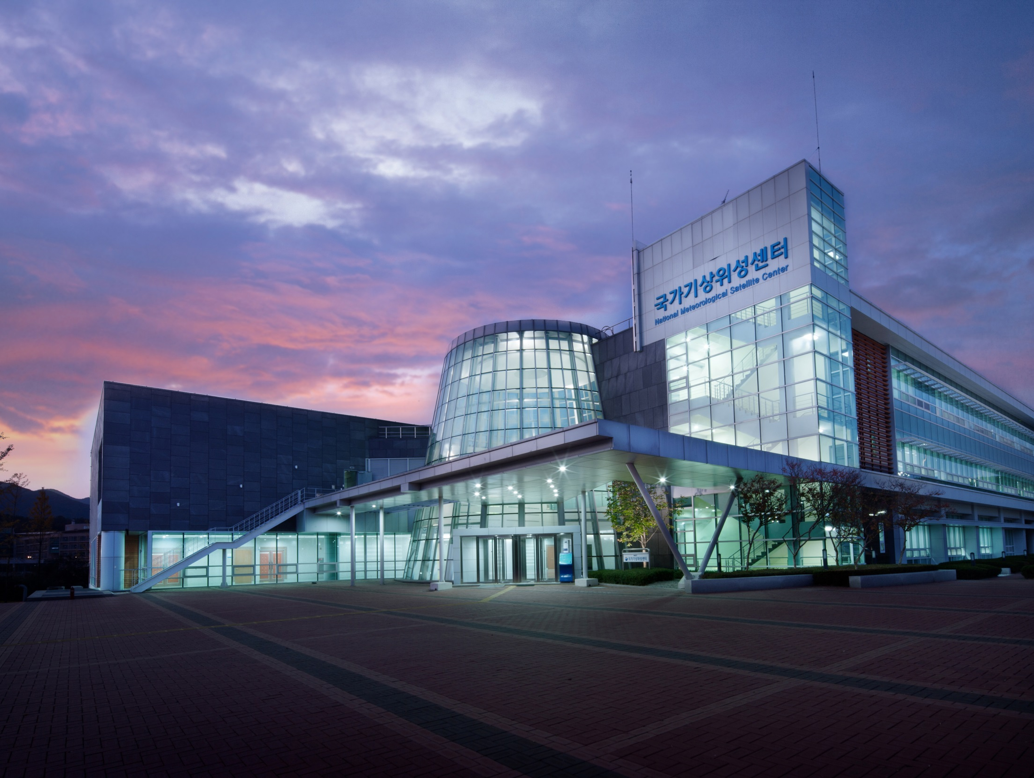

GODEX-NWP-2
KMA Report – Part 1(Satellite)
Hyunjong Oh (hyunjong.oh@korea.kr)

Slide 2
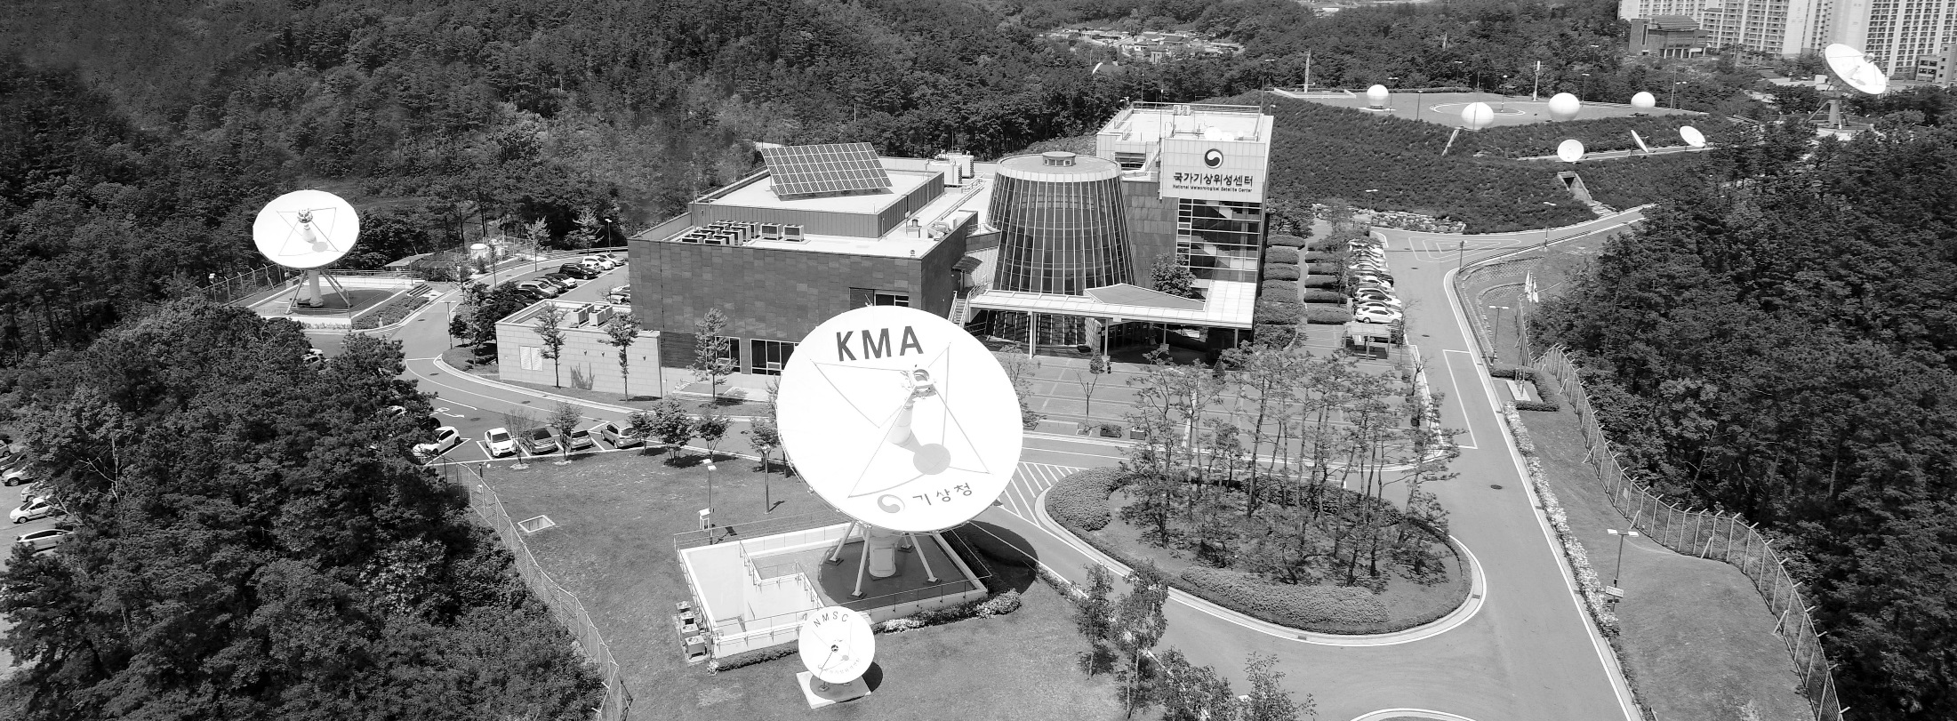
C O N T E N T S
01
Satellite Operation Status
02
Data Exchange Activities
(Y2017~Y2018)
03
Geo-KOMPSAT-2A
04
Future Plans

Slide 3
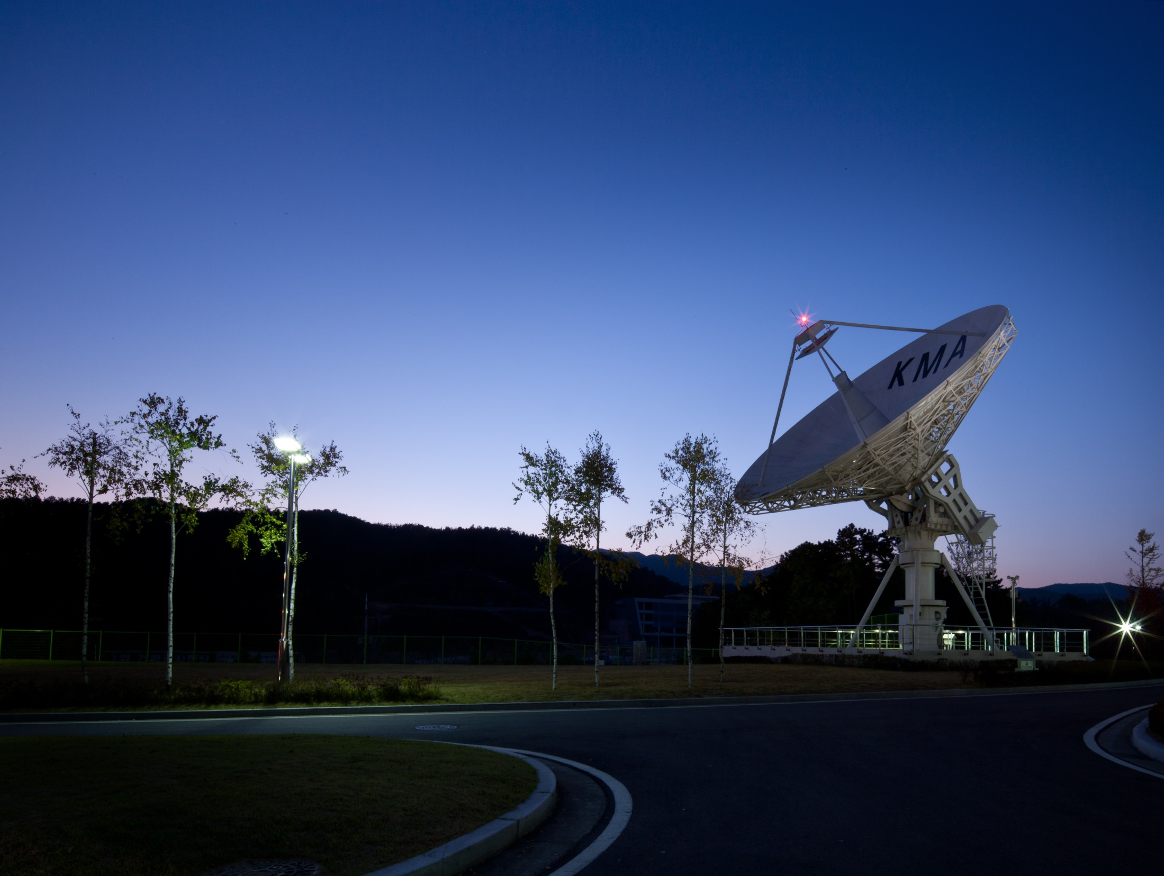

Satellite operation status

Slide 4
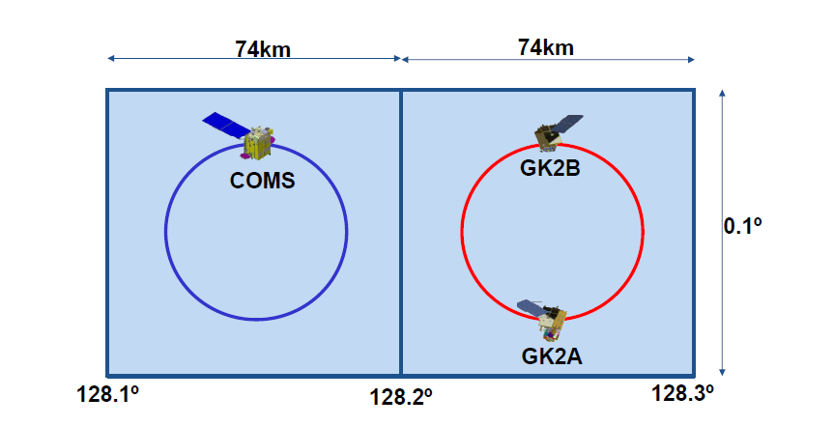


COMS Operation Status
The operation lifetime of COMS meteorological mission was extended 2 years (Apr. 2018 ~ Mar. 2020)
- No serious operation fault from Y2010 during 7 years
For Geo-KOMPSAT-2A(GK-2A) launch, COMS moved to 128.15E from 128.2E on 31st Aug, 2018
=> No change of operation orbit for data processing SW
GK-2A(5th Dec, 2018) and GK-2B(Y2020) will be co-operated on 128.2E.

Slide 5
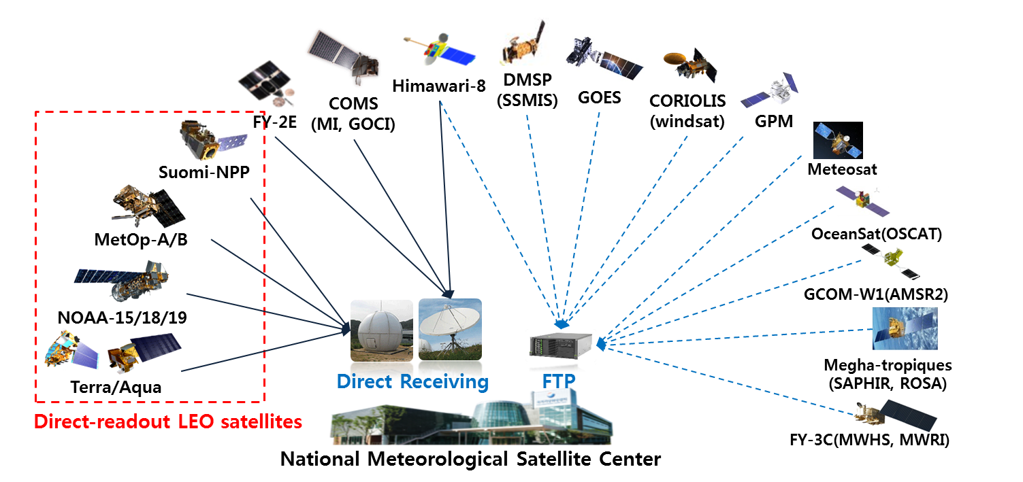
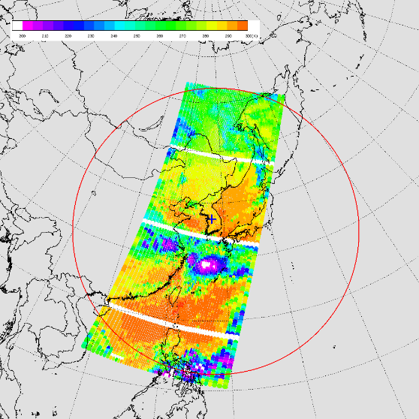
Satellite Data Reception Status
The status of satellite data reception of NMSC
Jincheon Coverage
AMV, CSR
ATMS & CrIS
IASI
ATOVS
http://nmsc.kma.go.kr/html/homepage/en/ver2/static/selectStaticPage.do?view=activities.rars.rarsInformation

Slide 6
2. Data Exchange Activities

Slide 7
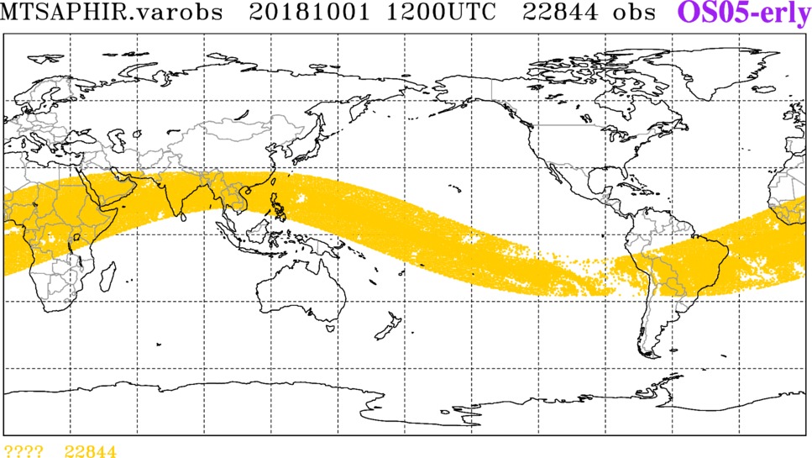
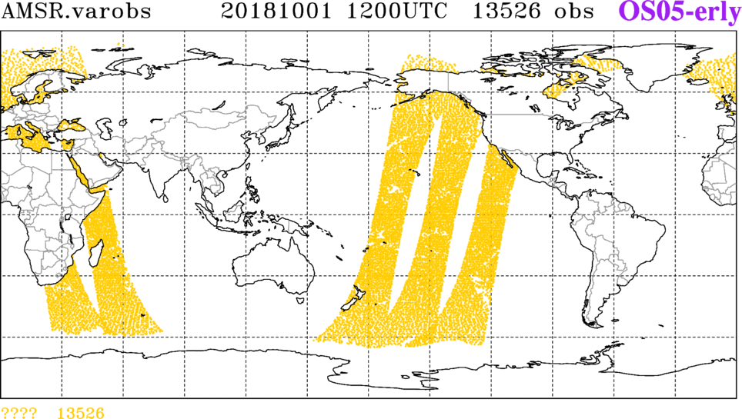
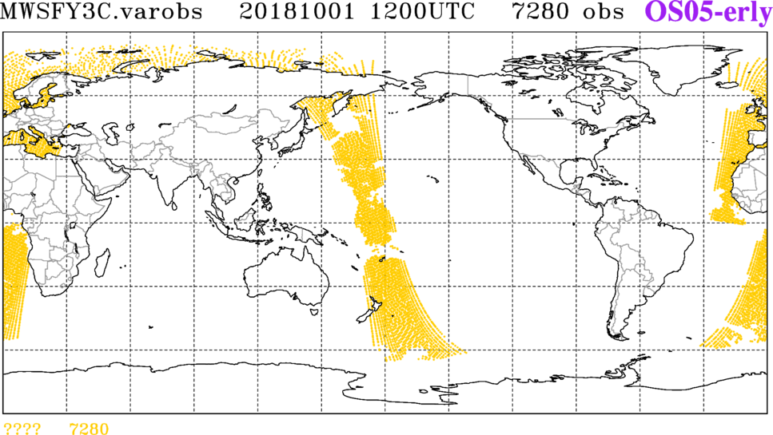
Sounder data collection for NWP
SAPHIR, AMSR-2 & MWHS-2 data has been collected and assimilated since Oct. of 2017 with cooperation of EUMETSAT, ISRO, Meteo-France, JAXA and CMA
.

Slide 8
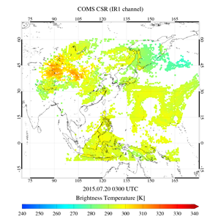
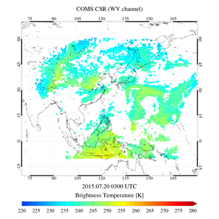
GEO Radiance 2.9 (AP-2.10)
COMS CSR and ASR - KMA, ECMWF and EUMETSAT to investigate mechanisms to make COMS CSR and ASR products available in real-time
COMS CSR data has been put on GTS since March of 2018
- INRC01_RKSL_201803250300.bfr
- Northern Hemisphere in every 15 min. / Full Disk in every 3 hours
No plan to generate ASR
.

Slide 9
Data release on GTS :
Direct readout S-NPP ATMS & CrIS
Data Processing Packages operated by NMSC
AMSU-A, MHS,
HIRS L0
ATOVS, IASI
L1C BUFR
AAPP V8.2
GTS
DBNet
AAPP
IASIL1C
ATOVS, MHS
L1D BUFR
Metopizer
NWP Model
NOAA-15/18/19
MetOp-A/B
IASI L0
L1C
IASI L1D BUFR
*OPS-LRS
AAPP
AAPP V8.2
ATMS, CrIS
L1C BUFR
ATMS CrIS
SDR
AAPP
GTS
DBNet
CSPP SDR V3.0
CSPP EDR V2.0
BUFR encoding
ATMS, CrIS
L1D BUFR
CADU
* RT-STPS
RDR
CSPP
NWP Model
Suomi-NPP
TDR, SDR, EDR
GTS release
S-NPP ATMS : Aug. 30th 2018
CrIS : Sep. 12th 2018
CSPP MIRS V2.0
* AHRPT: Advanced High Resolution Picture Transmission
* OPS-LRS: Operation Software - Local Reception Station
* RT-STPS: Real-Time Software Telemetry Processing System
* MIRS: Microwave Integrated Retrieval System
* UW-HSRTV: University of Wisconsin-madison Hyper Spectral Retrieval
* NUCAPS: NOAA Unique CrIS/ATMS Product System
TDR, SDR
* MIRS
CSPP UW-HSRTV V1.0
SDR
* UW-HSRTV
CSPP NUCAPS V1.1
CSPP
Package
TDR, SDR
* NUCAPS

Slide 10
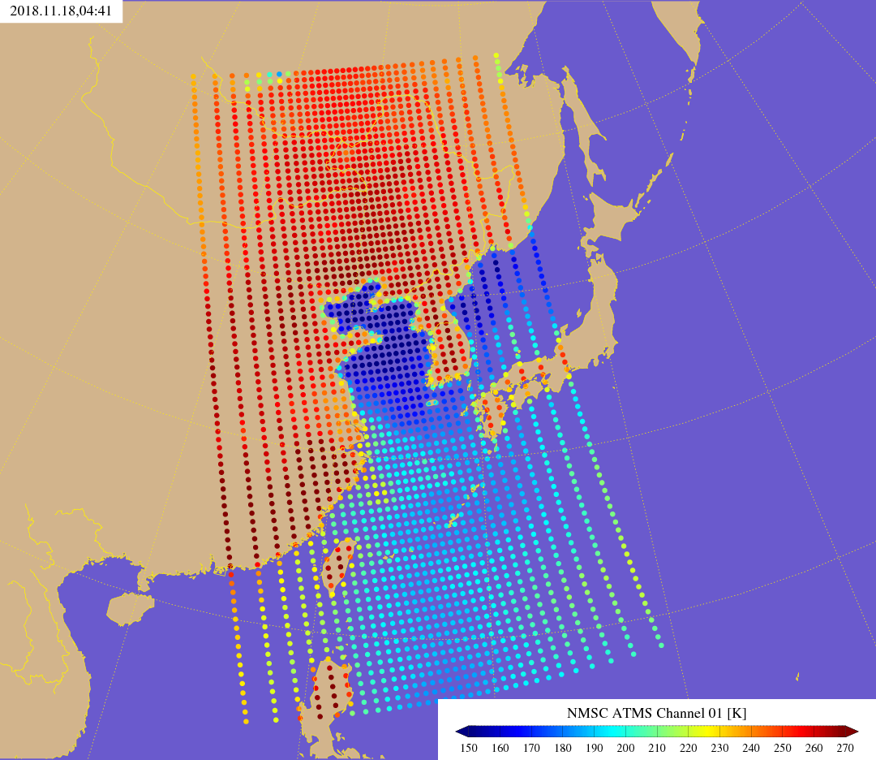
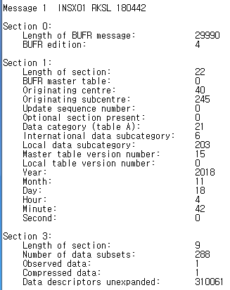
S-NPP ATMS Level 1C (30th Aug. 2018)
W_kr-KMA-jin,atms,DBNet+snpp+jin_C_RKSL_20181118052912_atms_snpp_20181118_0441_bufr.bin
2018. 11. 18. 04:41UTC (channel 01, 23.8GHz)
8

Slide 11
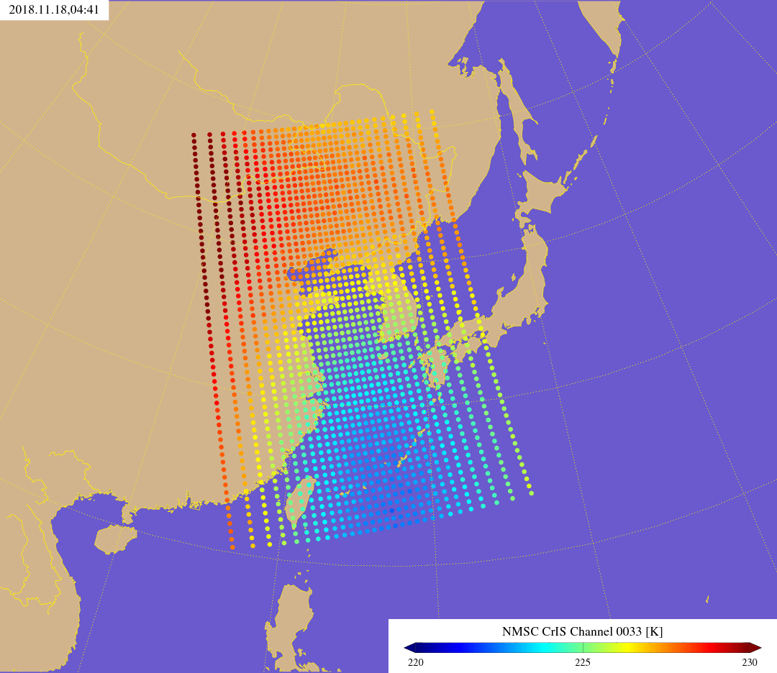
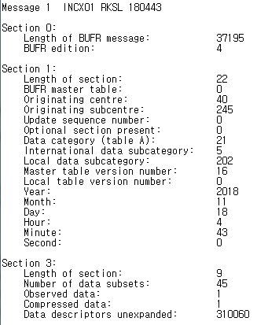
S-NPP CrIS Level 1C (12th Sep. 2018)
W_kr-KMA-jin,cris,DBNet+snpp+jin_C_RKSL_20181118052830_cris_snpp_20181118_0441_bufr.bin
2018. 11. 18. 04:41UTC (channel 0033, 14.925$μm$)
9

Slide 12
2. RO 7.10 (AP-1.9)
KOMPSAT-5 AOPOD - KMA to investigate real-time availability of KOMPSAT-5 radio-occultation data on the GTS (bending angles and refractivity)
Response : So far, no big improvement on real-time availability, so no feasibility of putting those data on GTS yet

Slide 13
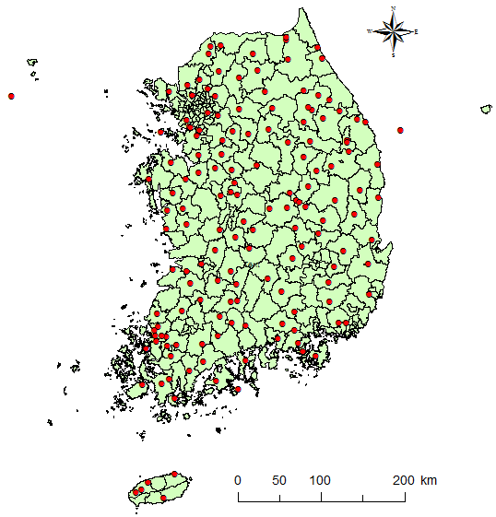
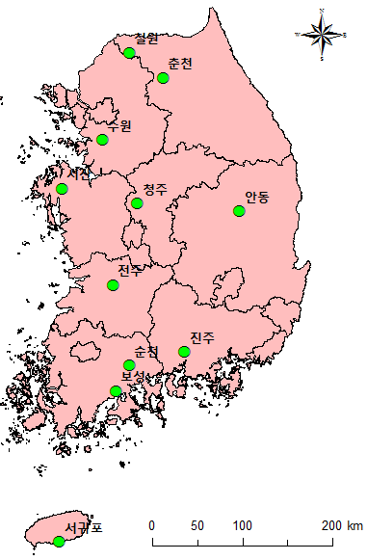
Action Items
N.4.7 All Centres to investigate putting soil temperature and moisture observations on the GTS. ACTION: All Centres
Response : KMA is still not use these data for NWP and also not ready to put those data on the GTS yet due to the data quality issue.
Current Status
- soil temperature obs. : 74 sites of KMA
- soil moisture obs. : 11 sites of KMA
158 sites of RDA (Rural Development Administration)
Soil Moisture obs. sites
11 sites managed by KMA
158 sites managed by RDA
11

Slide 14
2. Geo-KOMPSAT-2A

Slide 15
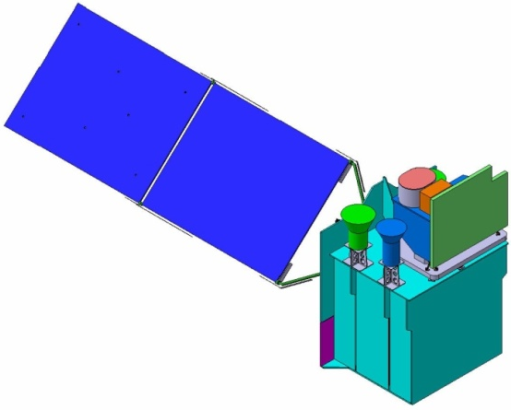
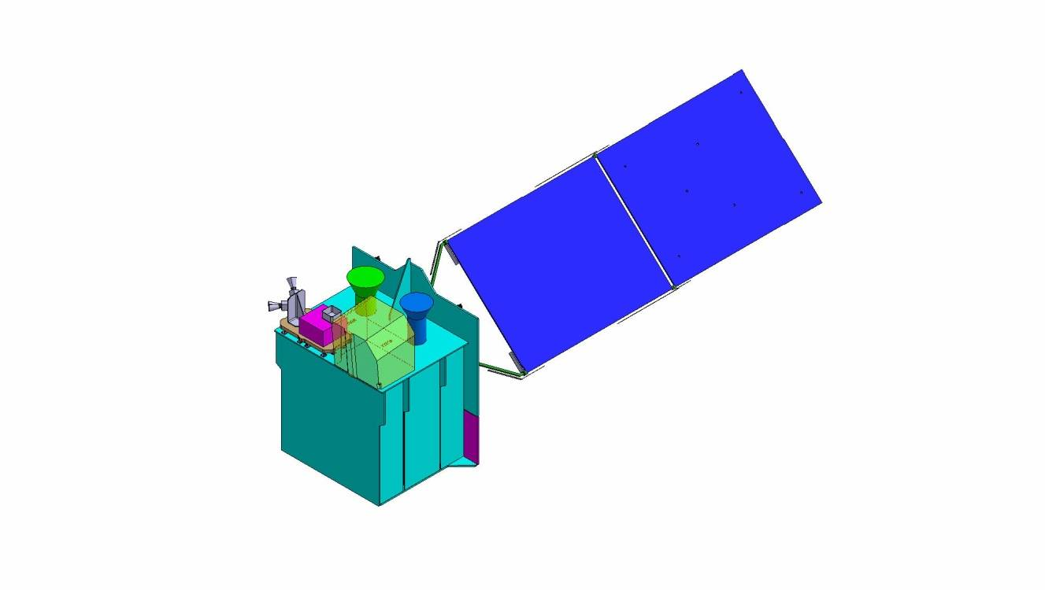

GeoKOMPSAT-2A and 2B
Specifications
 | GK-2A | GK-2B
Payload | AMI | GOCI-2 | GEMS
Lifetime | 10 years
Location | 36,000 km over equator at 128.2° E
Channels | 16 | 13 | 1000
Wavelength range | 0.4 – 13.3 μm | 375 - 860 nm | 300-500 nm
Spatial resolution | 0.5 & 1 km (Vis) 2 km (IR) | 250 m@ eq 1 km (FD) | 7 x 8 km² @ Seoul 3.5x8 km² (aerosol)
Temporal resolution | 10 min (FD) | 1 hour | 1 hour
GK-2A/AMI & KSEM
GK-2B/GEMS &
GOCI-2
  Launch: Dec. 2018
  Launch: 2nd Half 2019
AMI: Advanced Meteorological Imager
KSEM: Korean Space wEather Monitor
GOCI-2: Geostationary Ocean Color Imager-2
GEMS: Geostationary Environmental Monitoring Sensor

Slide 16
Geo-KOMPSAT-2A Payload
AMI (Resolution) |  | ABI | AHI
1 blue | 0.47 (1km) | 0.47 | 0.46
2 green | 0.511 (1km) |  | 0.51
3 red | 0.64 (0.5km) | 0.64 | 0.64
4 | 0.856 (1km) | 0.865 | 0.86
5 | 1.38 (2km) | 1.378
6 | 1.61 (2km) | 1.61 | 1.6
 |  | 2.25 | 2.3
7 | 3.830 (2km) | 3.90 | 3.9
8 | 6.241 (2km) | 6.185 | 6.2
9 | 6.952 (2km) | 6.95 | 7.0
10 | 7.344 (2km) | 7.34 | 7.3
11 | 8.592 (2km) | 8.50 | 8.6
12 | 9.625 (2km) | 9.61 | 9.6
13 | 10.403 (2lkm) | 10.35 | 10.4
14 | 11.212 (2km) | 11.2 | 11.2
15 | 12.364 (2km) | 12.3 | 12.3
16 | 13.31 (2km) | 13.3 | 13.3
vs. AHI
- addition 1.38 μm (NIR)
- subtraction 2.3 μm (NIR)
1.38 μm : favorable for cirrus cloud detection, cloud type and amount
2.3 μm : favorable for Land/cloud Properties
Bus design and review
Module integration
System Integration
Launch/IOT/OPS
2013
2014
2015
2016
2017
2018
2019
Kick-off
SRR
PDR
CDR
TRR
Test
AMI PSR
Launch
System
Req. analyss
Preliminary
Design
Critical
Design
payload
test
AIT
Prep. Launch
IOT, Ops
GK2A is scheduled to be launched on 5th November, 2018

Slide 17
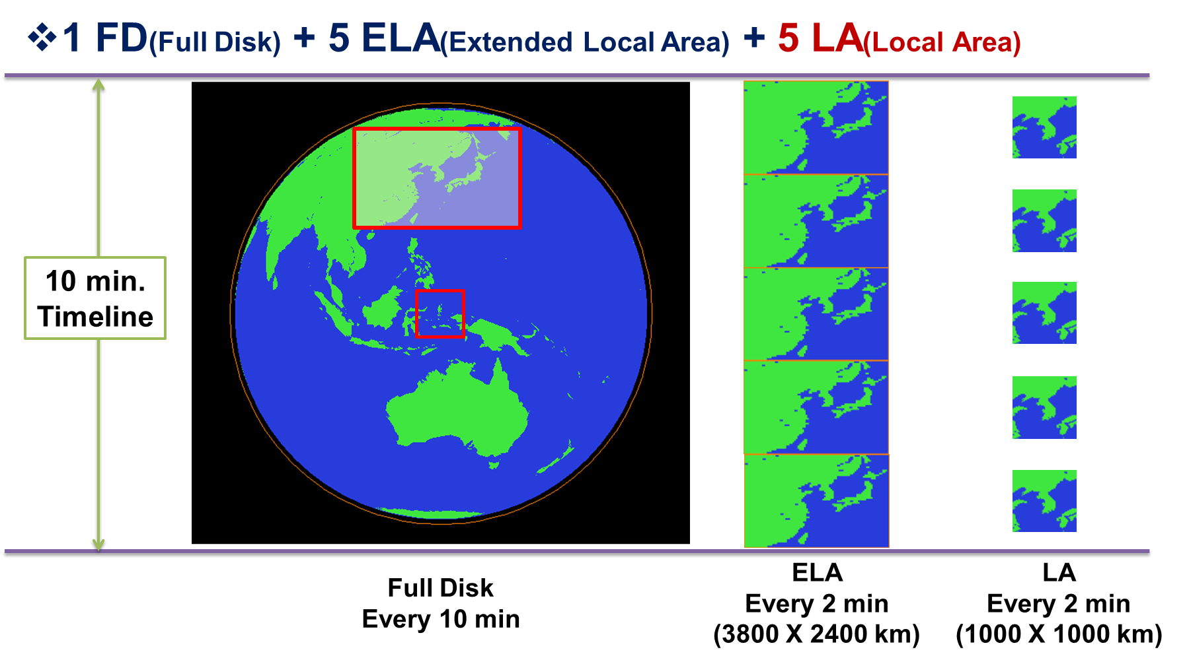
Observation Area and Schedule
1 FD + 5 ELA + 5 LA : 10 min
  Full Disk (FD)
  Extended Local Area (ELA) : 3800 X 2400 km (EW X NS)
  Local target Area (LA) 1000 X 1000 km

Slide 18
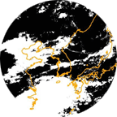
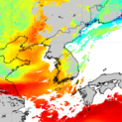
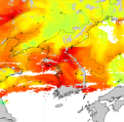
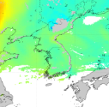
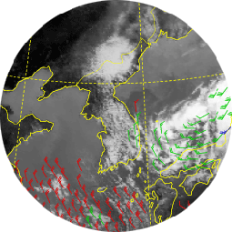
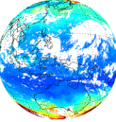
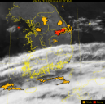
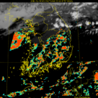
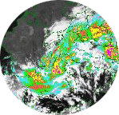
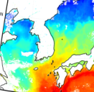

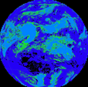

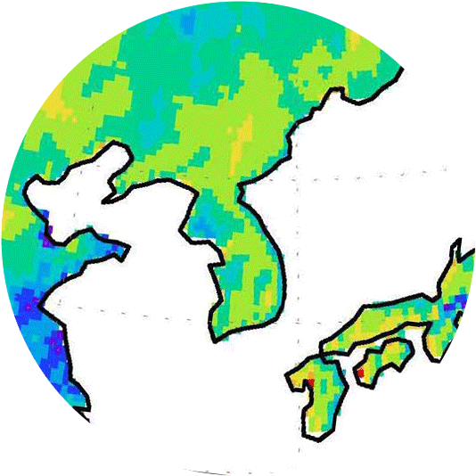
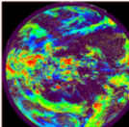
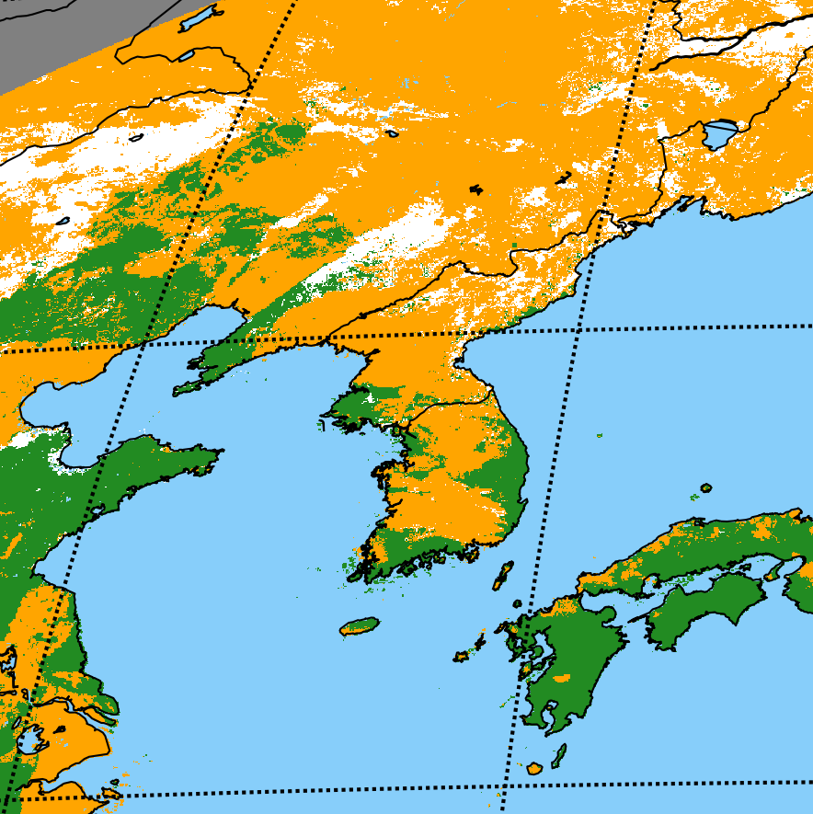
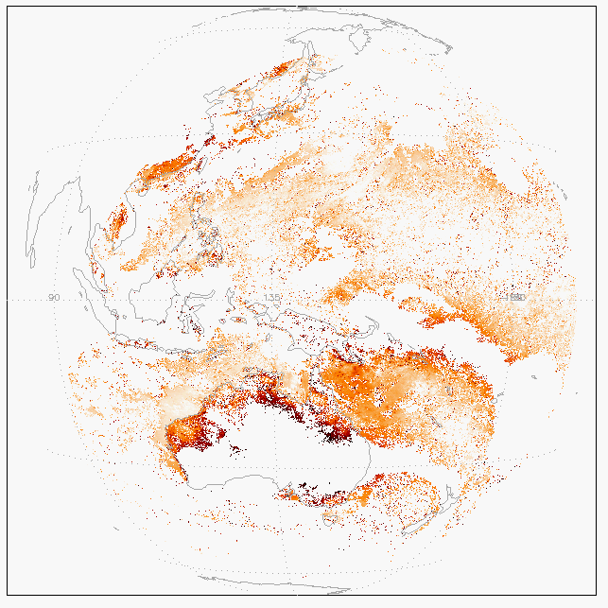
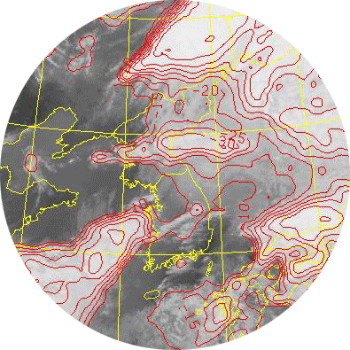
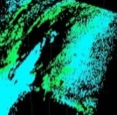
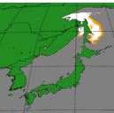
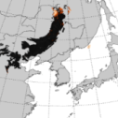
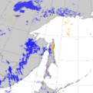
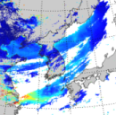
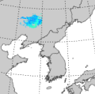
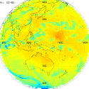
GK-2A/AMI Geophysical Products
Primary Products
Vertical
Moisture
Profile
Vertical
Temperature
Profile
Atmospheric
Motion
Vector
Convective Initiation
Cloud Detection
Instability Index
Total Ozone
Fog
Rainfall Rate
Sea Surface
Temperature
Cloud Phase
Land Surface
Temperature
Cloud Top Height
Cloud Top
Pressure
Snow Cover
Sea Ice Cover
Aerosol
Detection
Asian
Dust
Detection
Volcanic
Ash
Detection,
Height &
Mass
Aerosol
Optical
Depth
Asian
Dust
Optical
Depth
Radiance
Cloud Top
Temperature
Snow Depth
Ocean Current
Cloud Type
Cloud Amount
Cloud Optical Depth
Cloud Effective Radius
Cloud Liquid Water Path
Cloud Ice Water Path
Cloud Layer/Height
Probability of Rainfall
Rainfall Potential
Aerosol Particle Size
Visibility
Absorbed SW Radiation (SFC)
Downward SW Radiation (SFC)
Reflected SW Radiation (TOA)
Downward LW Radiation (SFC)
Upward LW Radiation (SFC)
Upward LW Radiation (TOA)
Aircraft Icing
Secondary Products
Fire Detection
Vegetation Index
Vegetation Green Fraction
Surface Emissivity
Surface Albedo
Overshooting Top Detection
SO2 Detection
Total Precipitable Water
Clear Sky Turbulence

Slide 19
  Data Service Plan : Geo-KOMPSAT-2A
Via GK-2A broadcast (< 3 minutes data latency)
  Broadcast all 16 channels in full resolution (UHRIT)
  Maintain L/HRIT broadcast corresponding to COMS five channels
Via Landline
  Real-time cloud service similar to HimawariCloud will be also provided (< 5 min data latency)
  GK-2A data also will be available in DCPC-NMSC (http://dcpc.nmsc.kma.go.kr)
L1 Data Format
  netCDF4(for each channels), with GSICS information
L2 Data Format
  netCDF4(for each products)
L1 Data Header Structure
General Information
Output Information
Pixel File Information
Projection Information
Star Measurement Information
INR Characteristics Information
Image Geometry Quality Information using Star Measurements
Registered Image Information
Quality Area Image Information

Slide 20
3. Future Plans

Slide 21
Data Service Shift from COMS to GK-2A
COMS
COMS &
GK-2A
(‘19.7~’19.12)
End of COMS MI mission
2010.6.
2020.3
L1B data release
2018
2019.7
2020 ~
Launch
IoT/Operation
GK-2A
* IOT : In Orbit Test
GK-2A Level 1B release will be started in July of 2019
Level 2 will be open after verification and maturization
COMS data including AMV, CSR will be provided until end of 2019

Slide 22
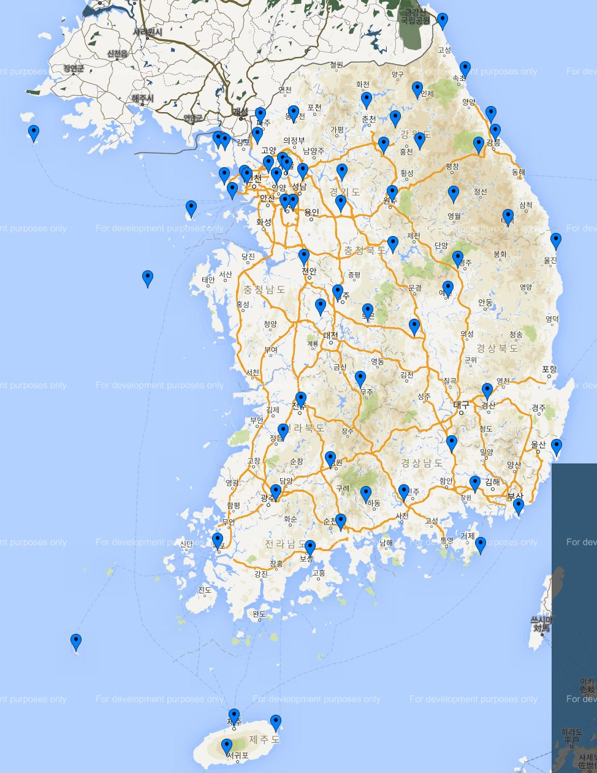
Ground GNSS ZTD(Zenith Total Delay)
KMA’s verifying the data quality and reception stability for 78 sites including sites of KMA’s (23 sites) and other government organizations(55 sites)
Hourly ZTD is being generated

Slide 23
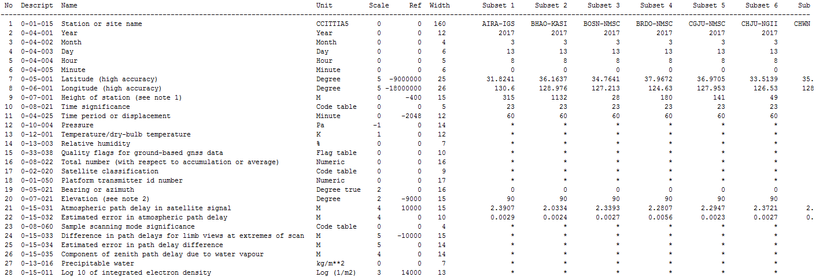
Ground GNSS ZTD(Zenith Total Delay) – Sample
KMA’s ground GNSS-based ZTD will be put on GTS in 1st half of 2019
ZTD BUFR Sample (converted in ASCII)
Naming Rule : RKSL_ISXC_${yyyy}${mm}${dd}${HH}.bfr
  ex) RKSL_ISXC_2018013104.bfr

Slide 24
Future Plans
To prepare to put GK-2A products on GTS
KMA’s first LEO Satellite program’s not approved in 2018, and thus postponed to 2~3 years later.
- Original plan : Y2022 launch with MW sounder

Slide 25
Future Plans
Direct-readout data collection and generation for NWP data assimilation
- EARS direct readout IASI
- EARS direct readout ATMS, CrIS
- NESDIS direct readout ATMS, CrIS
To prepare to direct-readout and process the NOAA-20 and Metop-C data

Slide 26
Thank you!

